Slide 1
Real Estates Consulting Proposal

Slide 2
TOC
Overview
Interests
Problems to solve
Target audience
Project objective
Proposed solution

Slide 3

Overview
For a real status company, it is hard to find the perfect location for a specific client. This project will benefit mostly real estate companies who are helping their clients decide where to live. This saves time when the company is facing a large number of clients.

Slide 4
Problems to solve
What’s out client’s preference of living locations?
How to extract data corresponding to each clients?
1
3
2
Where is our client moving to?
4
Will client be satisfied with our solution?

Slide 5
Project objective
Hypothetical situation:
Find a perfect location to live in Toronto

Slide 6
Process
Background: Trevor, who is a recent graduate, wants to move to a new place in Toronto. According to his background, he does not own a car and currently looking for a full-time job. He wants to move to a place where it is convenient to commute. Because of budget, he also wants his living expense to be reasonable. Meanwhile, he does not want to travel far for a quick meal in a local restaurant and he enjoys casual shopping and watching movies with friends.

Slide 7
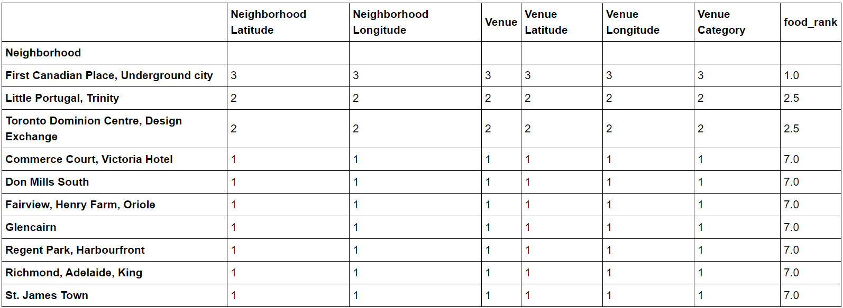
Restaurant
01
We group our data by venues which having the key word “Restaurant” and rank them from the most to least. For the rest factor, we do the same to them

Slide 8
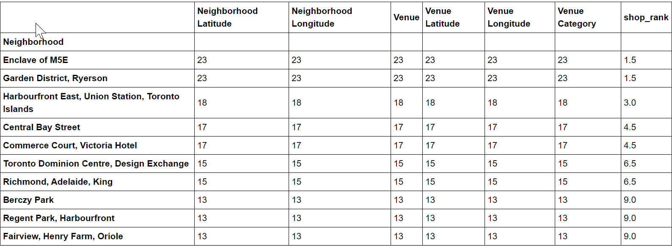
Shops
02

Slide 9
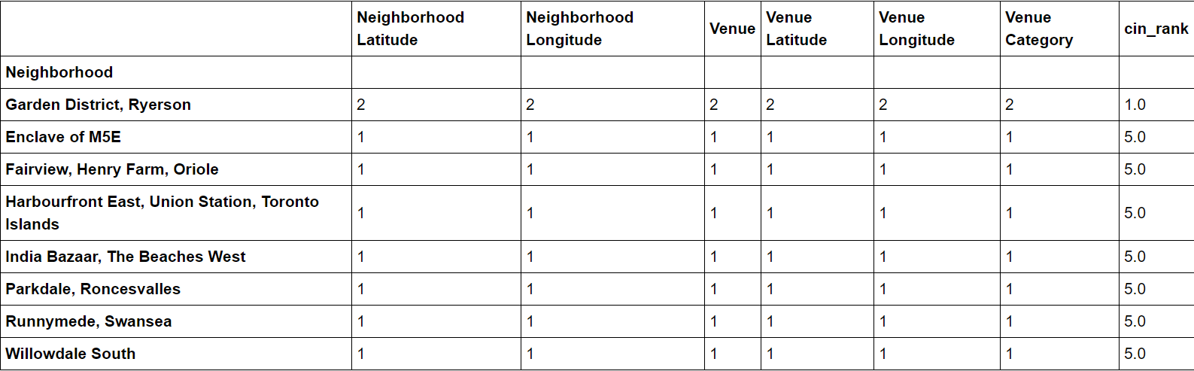
Cinema
03

Slide 10
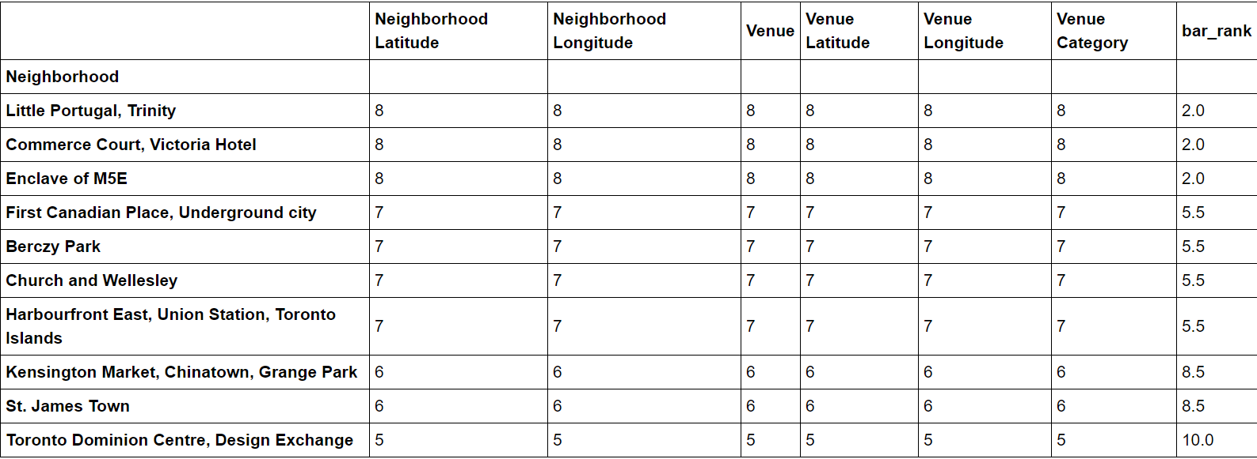
Bar
04

Slide 11

Concatenated Results
We concatenate four data frames on “neighborhood” index and the results only yields one area which shows above. However, our clients needs to commute. This area is close to highway which is not the perfect location.

Slide 12
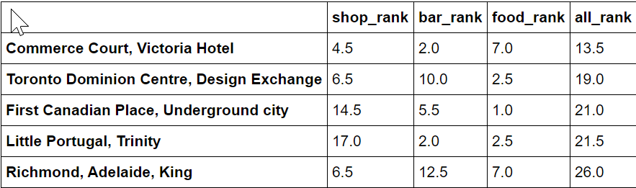
Remedy
We remove the theater category since it is not necessary to our client and we redo our process before and get the following candidates:

Slide 13
Proposed solution
Now after doing research on all five areas, we found that only Little Portugal, Trinity is suitable for living. The rest four areas are located in the financial district and commonly having high living expenses. According to our client’s background, he needs his living expenses to be reasonable. We conclude our client will be happy to live at Little Portugal, Trinity.

Slide 14
Will Client satisfy with our solution?
This depends on various factor. However we can improve our performance in many ways. Here is one way.
The data we collect from our client needs to be more specific. For instance, we might introduce ordinal data. So that our client can rank how strong a factor affects this client’s opinion of the choice of location. In case that our data do not represent a factor, we can omit it or remedy it in some other way according to the ordinal data.

